Slide 1
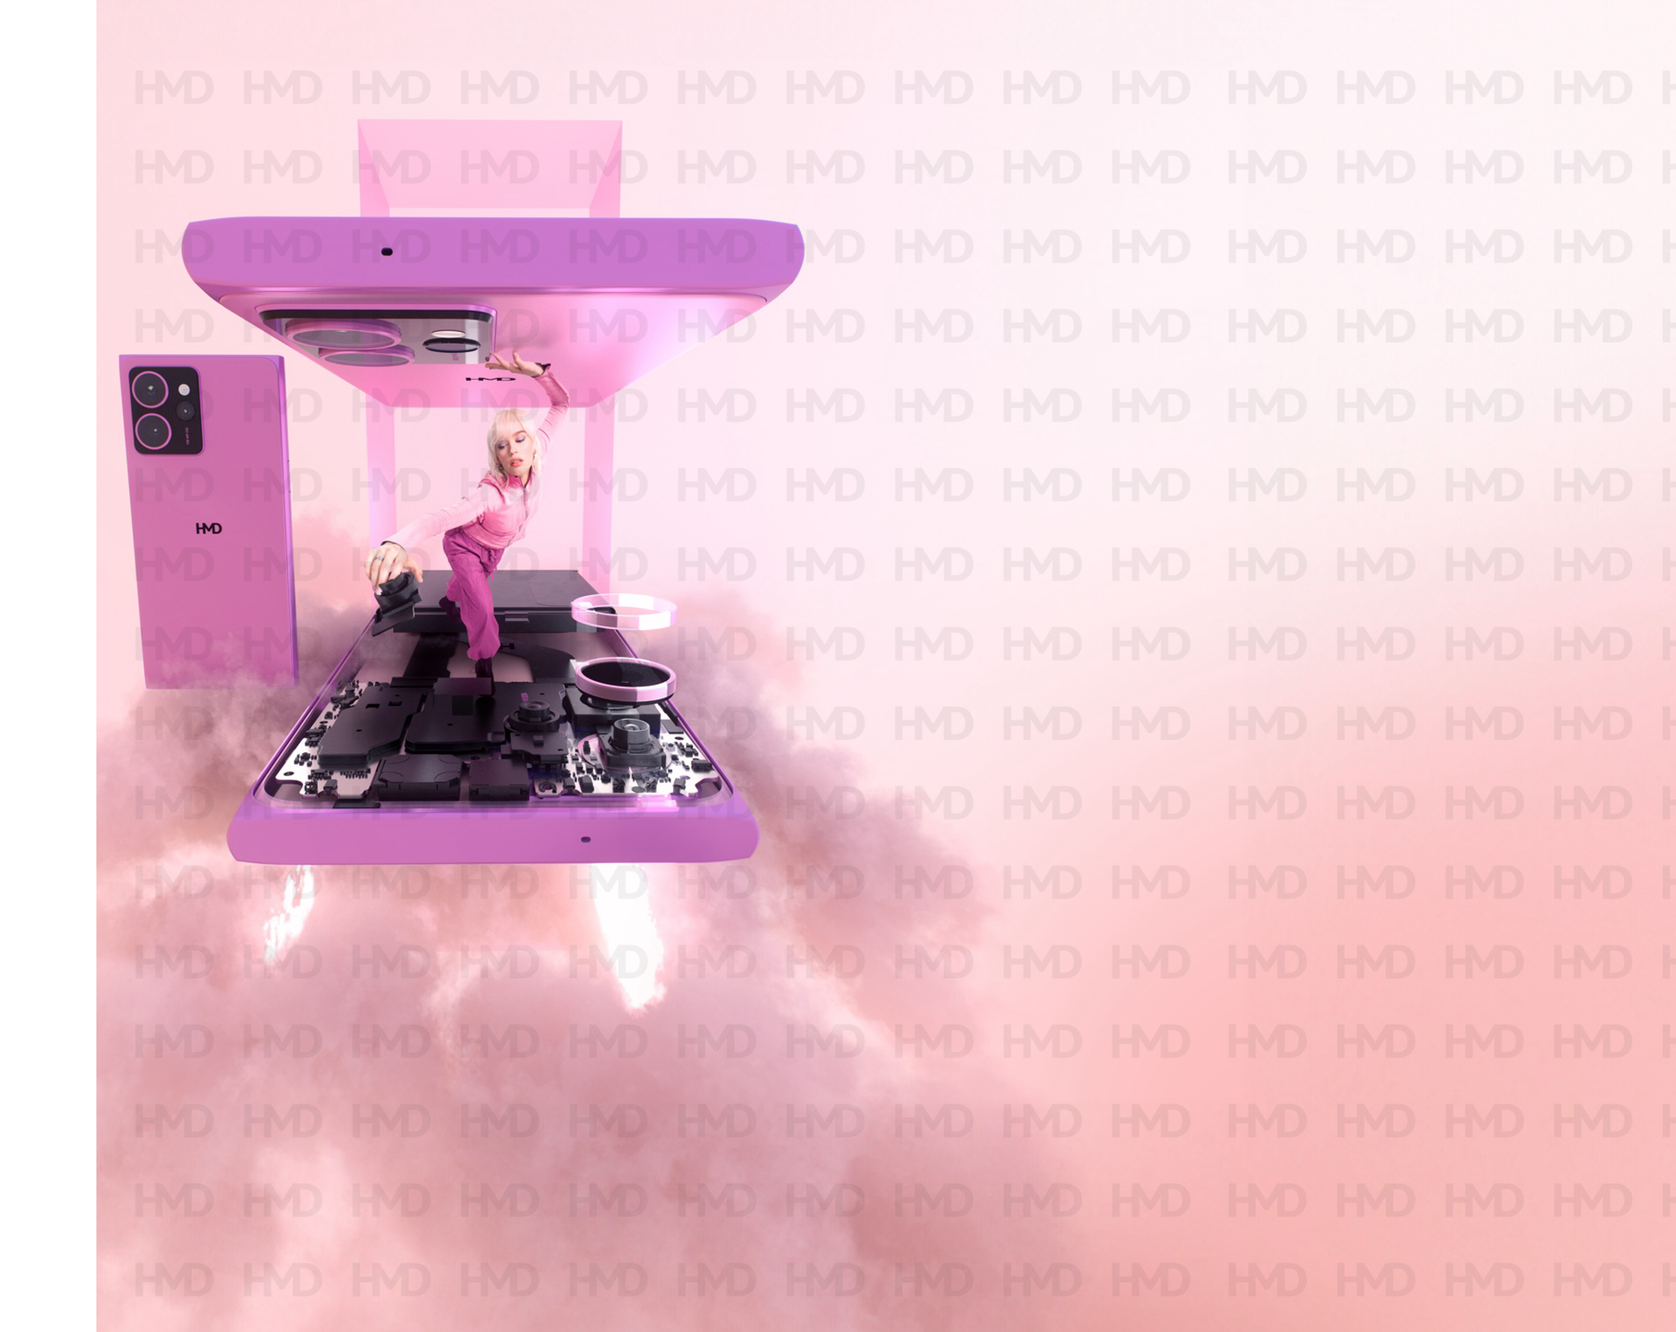
WHOEVER SAID SKY IS THE LIMIT?
Product specifications :
Band: | 2G: 850, 900, 1800, 1900 | 3G: 1, 2, 4, 5, 8 4G: 1, 2, 3, 4, 5, 7, 8, 12, 13, 17, 20, 25, 26, 28, 32, 38, 40, 41, 66, 71 5G² SA+NSA: n1, n2, n3, n5, n7, n8, n20, n25, n28, n38, n40, n41, n48, n66, n71, n77, n78
OS: | Android™ 14
CPU: | Snapdragon® 7s Gen 2
Memory and storage: | 8/128 GB³, 8/256GB³, 12/256GB³ | Micro SD card support up to 1GB | Google Drive
Display: | 6.55” FHD+ 20:9 (1080 x 2400) | 144Hz refresh rate | Brightness 1000 nits | NTCS 100% | Corning® Gorilla® Glass 3 | Miracast
Camera and flash: | Main: 108 MP OIS AF Main + 13 MP FF Ultrawide + 50 MP Telephoto | Flash | | Front: 50MP AF with eye-tracking focus Features: Hybrid OIS+EIS | 50mm Portrait mode | Night mode 3.0 | 0.5x to 4x zoom | AI Portrait | UW and Tele Capture Fusion | Selfie Gestures| Selfie Slo-mo | 4K video capture | OZO Spatial Audio capture with wind-noise cancellation
Connectivity: | 802.11 b/g/n/ac/ax/6e (2x2 MiMo) | Bluetooth® 5.2 with LE Audio | GPS; A-GPS, Galileo L1/L5 dual band, GLONASS, BDS | Ambient light sensor | Proximity sensor | Accelerometer (G-sensor 6-axis) | E-compass | Barometer | NFC
Battery: | 4600mAh⁴ |>80% after 800 charging cycles⁵ | Up to 48-hours battery life⁶ | 33W charging support (QC4.0 and PD3.0 PPS compatible) | 15W magnetic wireless charging | 5W reverse wireless charging | Qi2 certified
I/O: | USB Type-C™ (USB 2.0) | Analog audio output | OTG
Dimensions: | 159.84 * 75.66 * 8.9 mm | Weight 209.5g
SIM slot: | Nano SIM + Nano SIM/Micro SD Card slot (3-in-2) | eSIM
Other: | Gen2 repairability with display, back cover, battery and charging port repairs through iFixit¹ | 100% recycled AL frame | Stereo speakers | HAC2019 | IP54 | Programmable Custom Button and Power Button | Biometric face unlock | Side fingerprint sensor | aptX Adaptive R2.1 HQ & Gaming, aptX HD, aptX Classic | OZO Payback | Android Enterprise Recommended
Your shots are about to take off
One for the creators; 50 MP AF selfies with eye-tracking, 108MP Hybrid OIS main camera, 50MP Telephoto for 4x zoom and 13MP UW for the perfect 0.5x selfies or landscapes. Throw in things like Selfie Gestures, Capture Fusion and 50mm portraits, you’ll be in creator mode in no time.
Just pop the hood and replace a cracked screen¹
Most of us know the feeling of dropping a phone and cracking the screen. With HMD Skyline, it’s not that big of a deal. Its Gen2 repairability basically means that you can just pop off the back cover and you’re in. Best of all, the phone looks like it comes from a catwalk with its stunning, and smart design.
Now with Detox Mode
We can’t turn off all the background noise in your life but we can help you hit pause and take a moment. Activate the Digital Detox Mode to disable the visibility of your social apps. Don’t worry, they’ll be there when you turn the mode off. Until then, enjoy some time in the real world. We’ve also added a touch more zen to the rest of your Android™. The Balance Interface, has a few things moved around to make finding them easier. It even sounds more chill with alarms, notification sounds and ringtones that won’t have you jumping out of your skin.
The Custom Button
Make your phone more “you” with the Custom Button. You can set it up so that it does one thing when you hold it, and another thing when you double-press it. It’s your shortcut to your favourite game, navigating home, asking the AI-powered assistant of your choice weird questions, and more.
HMD SKYLINE
TM and © 2024 HMD Global. All rights reserved. Snapdragon is a product of Qualcomm Technologies, Inc. and/or its subsidiaries. Snapdragon is a trademark or registered trademark of Qualcomm Incorporated. Android and Google Drive are trademarks of Google LLC. OZO is a trademark of Nokia Technologies Oy. Variations on offering may apply. Check local availability. All specifications, features and other product information provided are subject to change without notice. All images are for illustrative purposes only.
¹Self-repair support available through iFixit in select markets. Details available at https://www.hmd.com/self-repair ²5G coverage is limited and might not be supported by your network service provider. Actual speed depends on network and other factors. ³Pre-installed system software and apps use a significant part of memory space. ⁴Battery has limited recharge cycles and battery capacity reduces over time. Eventually the battery may need to be replaced. . ⁵Battery has been tested by HMD Global to maintain at least 80% of its original capacity after 800 full charging cycles. ⁶Battery testing was conducted by HMD Global Oy using a real-life usage test. Testing included cycles combining 30 minutes of active usage and 2 hours of idle time with a new battery, starting from 100% battery charge until the device powered off. Usage included e.g., gaming, video streaming, video playback, calling, browsing, and data transfer. Testing was conducted with normal device settings in a lit indoor environment.
Sales package contents:
Device
SIM pin
USB Type-C™ to Type-C cable
Quick Start guide
Safety Booklet
Twisted Black
Colours:
Neon
Pink

Slide 2

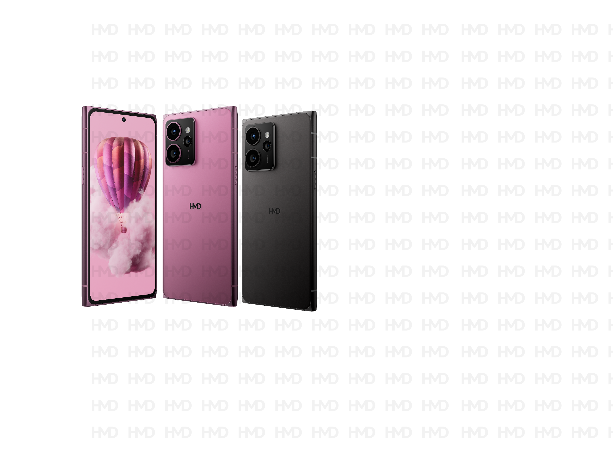
WHOEVER SAID SKY IS THE LIMIT?
Product specifications :
Band: | 2G: 850, 900, 1800, 1900 | 3G: 1, 2, 4, 5, 8 4G: 1, 2, 3, 4, 5, 7, 8, 12, 13, 17, 20, 25, 26, 28, 32, 38, 40, 41, 66, 71 5G² SA+NSA: n1, n2, n3, n5, n7, n8, n20, n25, n28, n38, n40, n41, n48, n66, n71, n77, n78
OS: | Android™ 14
CPU: | Snapdragon® 7s Gen 2
Memory and storage: | 8/128 GB³, 8/256GB³, 12/256GB³ | Micro SD card support up to 1GB | Google Drive
Display: | 6.55” FHD+ 20:9 (1080 x 2400) | 144Hz refresh rate | Brightness 1000 nits | NTCS 100% | Corning® Gorilla® Glass 3 | Miracast
Camera and flash: | Main: 108 MP OIS AF Main + 13 MP FF Ultrawide + 50 MP Telephoto | Flash | | Front: 50MP AF with eye-tracking focus Features: Hybrid OIS+EIS | 50mm Portrait mode | Night mode 3.0 | 0.5x to 4x zoom | AI Portrait | UW and Tele Capture Fusion | Selfie Gestures| Selfie Slo-mo | 4K video capture | OZO Spatial Audio capture with wind-noise cancellation
Connectivity: | 802.11 b/g/n/ac/ax/6e (2x2 MiMo) | Bluetooth® 5.2 with LE Audio | GPS; A-GPS, Galileo L1/L5 dual band, GLONASS, BDS | Ambient light sensor | Proximity sensor | Accelerometer (G-sensor 6-axis) | E-compass | Barometer | NFC
Battery: | 4600mAh⁴ |>80% after 800 charging cycles⁵ | Up to 48-hours battery life⁶ | 33W charging support (QC4.0 and PD3.0 PPS compatible) | 15W magnetic wireless charging | 5W reverse wireless charging | Qi2 certified
I/O: | USB Type-C™ (USB 2.0) | Analog audio output | OTG
Dimensions: | 159.84 * 75.66 * 8.9 mm | Weight 209.5g
SIM slot: | Nano SIM + Nano SIM/Micro SD Card slot (3-in-2) | eSIM
Other: | Gen2 repairability with display, back cover, battery and charging port repairs through iFixit¹ | 100% recycled AL frame | Stereo speakers | HAC2019 | IP54 | Programmable Custom Button and Power Button | Biometric face unlock | Side fingerprint sensor | aptX Adaptive R2.1 HQ & Gaming, aptX HD, aptX Classic | OZO Payback | Android Enterprise Recommended
Your shots are about to take off
One for the creators; 50 MP AF selfies with eye-tracking, 108MP Hybrid OIS main camera, 50MP Telephoto for 4x zoom and 13MP UW for the perfect 0.5x selfies or landscapes. Throw in things like Selfie Gestures, Capture Fusion and 50mm portraits, you’ll be in creator mode in no time.
Just pop the hood and replace a broken screen in minutes¹
Most of us know the feeling of dropping a phone and cracking the screen. With HMD Skyline, it’s not that big of a deal. Its Gen2 repairability basically means that you can just pop off the back cover and you’re in. Best of all, the phone looks like it comes from a catwalk with its stunning, and smart design.
Now with Detox Mode
We can’t turn off all the background noise in your life but we can help you hit pause and take a moment. Activate the Digital Detox Mode to disable the visibility of your social apps. Don’t worry, they’ll be there when you turn the mode off. Until then, enjoy some time in the real world. We’ve also added a touch more zen to the rest of your Android™. The Balance Interface, has a few things moved around to make finding them easier. It even sounds more chill with alarms, notification sounds and ringtones that won’t have you jumping out of your skin.
The Custom Button
Make your phone more “you” with the Custom Button. You can set it up so that it does one thing when you hold it, and another thing when you double-press it. It’s your shortcut to your favourite game, navigating home, asking the AI-powered assistant of your choice weird questions, and more.
HMD SKYLINE
TM and © 2024 HMD Global. All rights reserved. Snapdragon is a product of Qualcomm Technologies, Inc. and/or its subsidiaries. Snapdragon is a trademark or registered trademark of Qualcomm Incorporated. Android and Google Drive are trademarks of Google LLC. OZO is a trademark of Nokia Technologies Oy. Variations on offering may apply. Check local availability. All specifications, features and other product information provided are subject to change without notice. All images are for illustrative purposes only.
¹Self-repair support available through iFixit in select markets. Details available at https://www.hmd.com/self-repair ²5G coverage is limited and might not be supported by your network service provider. Actual speed depends on network and other factors. ³Pre-installed system software and apps use a significant part of memory space. ⁴Battery has limited recharge cycles and battery capacity reduces over time. Eventually the battery may need to be replaced. . ⁵Battery has been tested by HMD Global to maintain at least 80% of its original capacity after 800 full charging cycles. ⁶Battery testing was conducted by HMD Global Oy using a real-life usage test. Testing included cycles combining 30 minutes of active usage and 2 hours of idle time with a new battery, starting from 100% battery charge until the device powered off. Usage included e.g., gaming, video streaming, video playback, calling, browsing, and data transfer. Testing was conducted with normal device settings in a lit indoor environment.
Sales package contents:
Device
SIM pin
USB Type-C™ to Type-C cable
Quick Start guide
Safety Booklet
Twisted Black
Colours:
Neon
Pink

